Slide 1
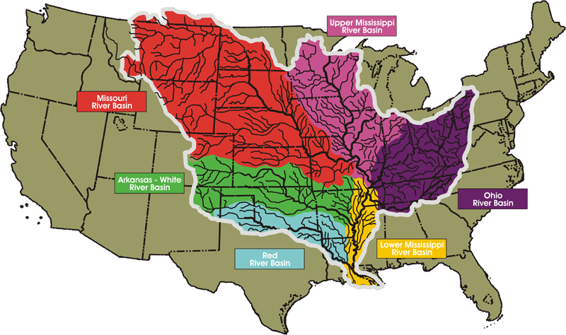
The Mississippi Basin Drains 41% of the Contiguous United States
Missouri
Ohio
Mississippi River
Length - 3730 km
Average flow – 12,700,000 m³/s
Max Flow -85,000 m³/s
Mississippi River Basin
3.1 million km²
32% of total US farm acreage
Mississippi

Slide 2
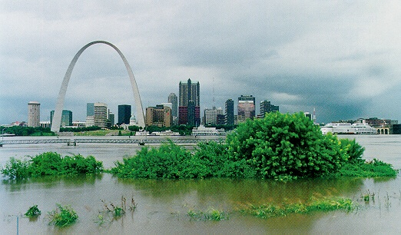

Slide 3
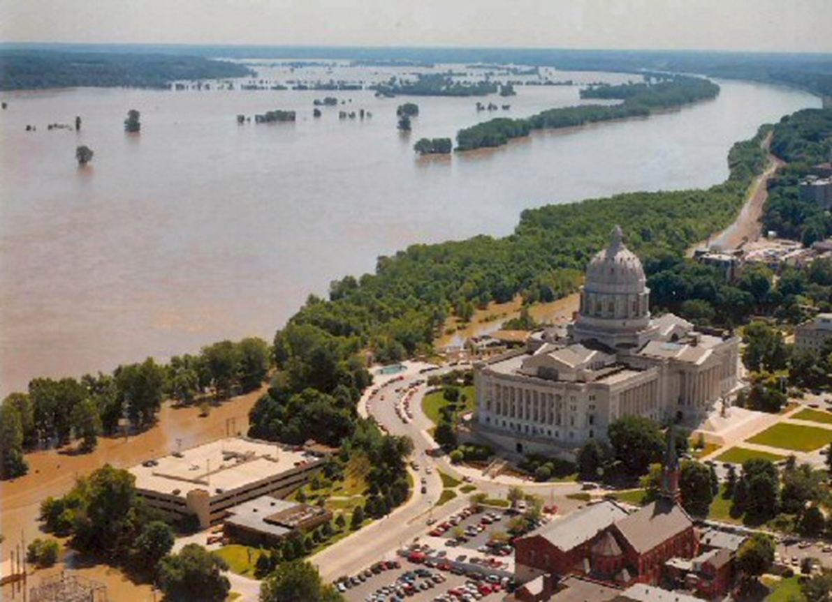

Slide 4
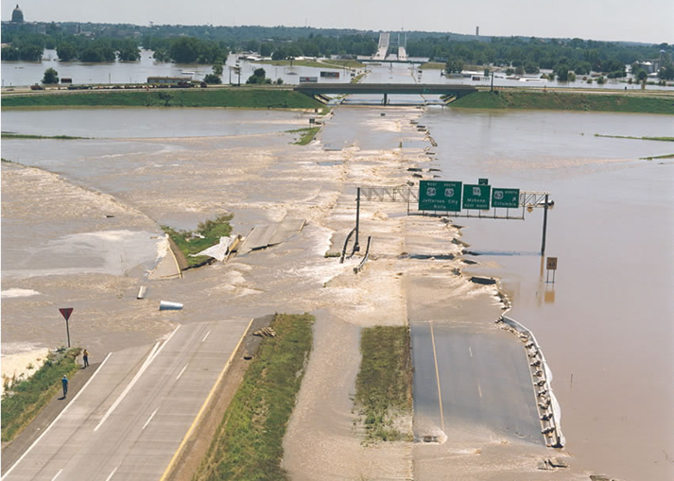
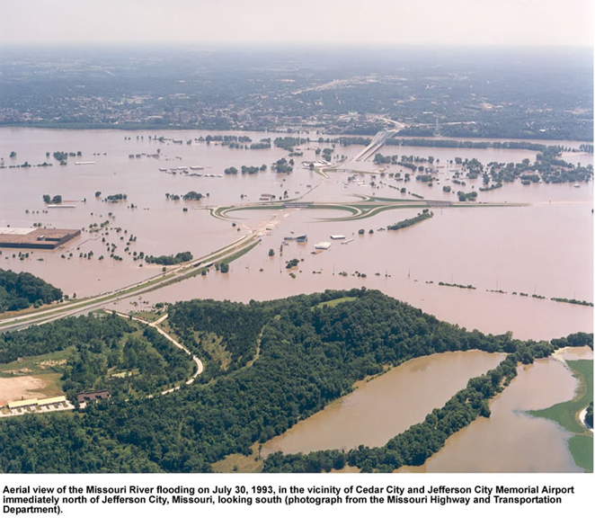
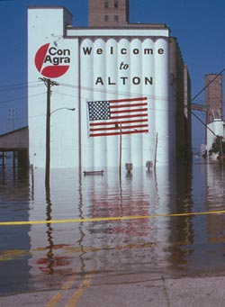
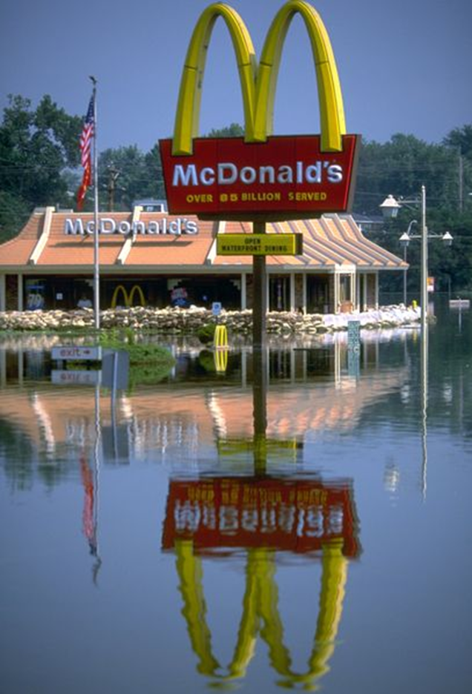

Slide 5
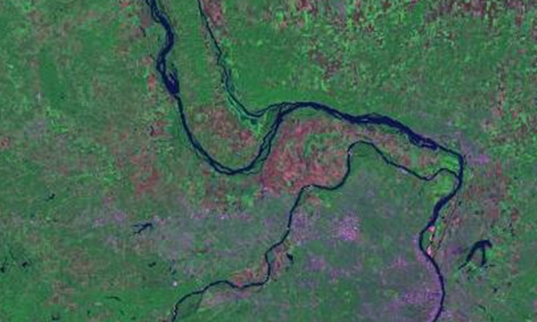
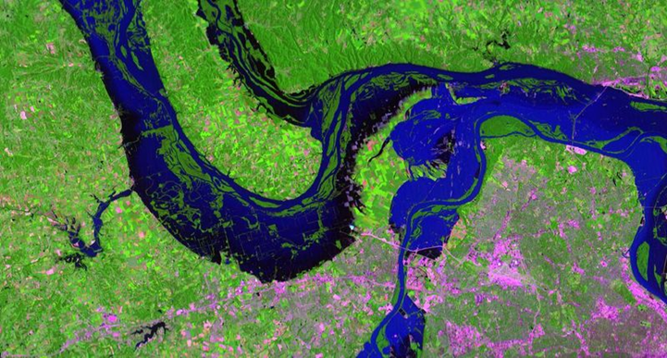

Slide 6
The Great Mississippi River Flood of 1993
May - October 1993
Among the most costly and devastating flood to ever occur in the United States measured by duration, area inundated, persons displaced, crop and property damage, and record river levels
$15 billion in damages (1993).
Flooded area = 30,000 square miles
Some locations on the Mississippi River flooded for almost 200 days ; Clarksville, Missouri, for 187 days; Winfield, Missouri, 183 days; Hannibal, Missouri, 174 days; and Quincy, Illinois, 152 days.
Missouri River above flood stage for 62 days in Jefferson City, 77 days at Hermann, and for 94 days at St. Charles in the St. Louis metropolitan area.
Approximately 100,000 homes were destroyed or damaged
15 million acres of farmland inundated,
Whole and parts of towns relocated
32 Fatalities
Large amounts of sand scovered the farmlands and homes.

Slide 7





and NOT Learn
>
What Did We and the World Learn from the Great Flood of 1993?
Gerald E. Galloway, Jr., PE, PhD
Glenn L. Martin Institute Professor of Engineering, University of Maryland
Eminent Scholar in Residence and Visiting Professor, Texas A&M – Galveston
gegallo@umd.edu

Slide 8


Slide 9

White House Floodplain Management Review Committee
1993-1994
Determine Causes of '93 Flood
Evaluate Floodplain Management Programs
Recommend Changes in Policies Programs and Procedures

Slide 11
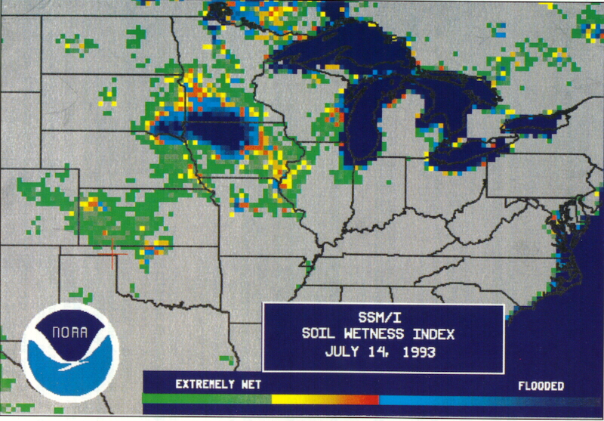
THE FLOOD OF 1993
Flood Was Significant Hydrometeorologic Event

Slide 12
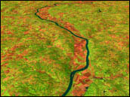
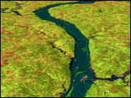
Levees and Locks & Dams Did Not Cause the '93 Flood (Federal Dams and Levees Prevented Damages)
Loss of Wetlands and Upland Natural Storage Did Not Cause the Flood, BUT...

Slide 13
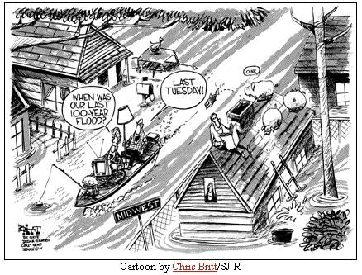
Major Floods Will Continue to Occur

Slide 14
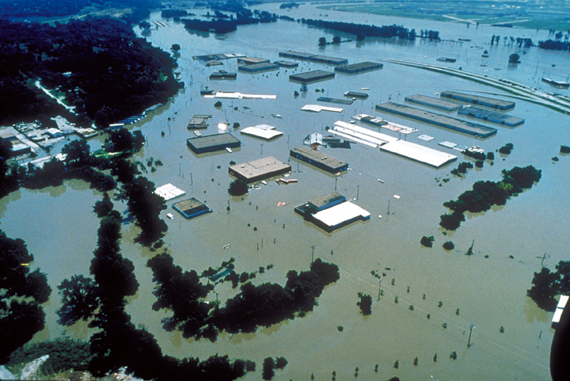
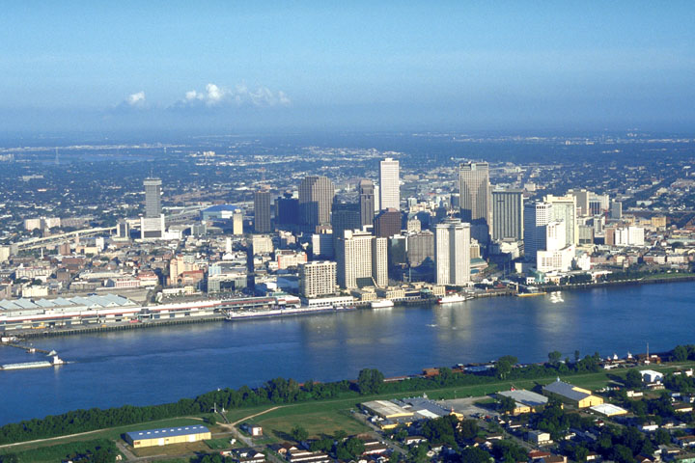
People and Property Are at Risk in the Floodplain
  Most Floodplain Residents Don’t Understand the Risk
  Many Structures Unnecessarily Located in Floodplain

Slide 15
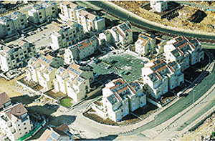
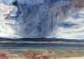
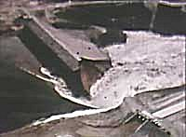
….and It Isn’t Going to Get Any Better
  Increased Development/Growth
  Climate Change/Climate Variability
  Uncertainty

Slide 16
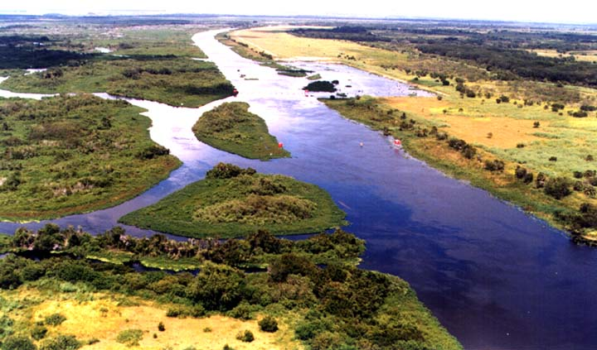
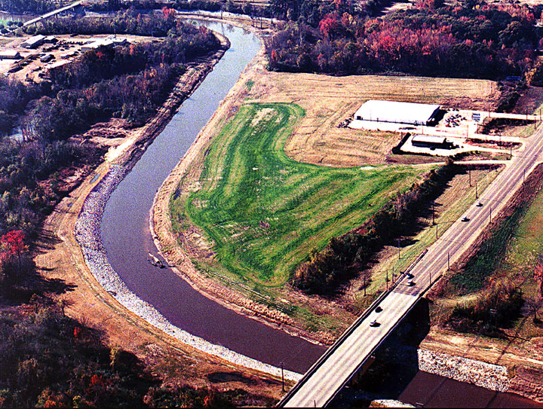
Human Activity Caused Significant Habitat Loss

Slide 17

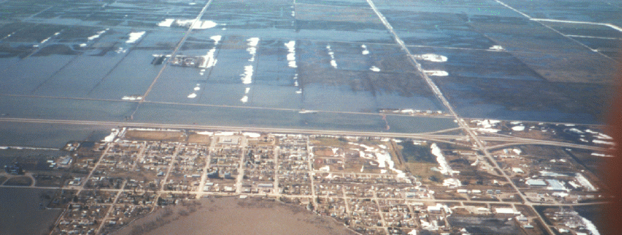
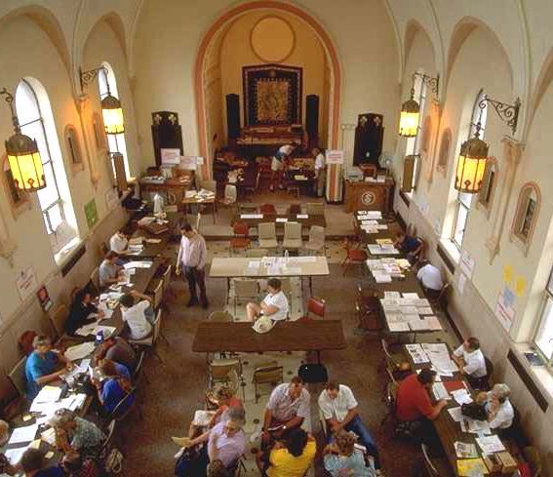
Participation in Flood Insurance Program Poor
Management of Floodplain and Basin Activities Diffused

Slide 18
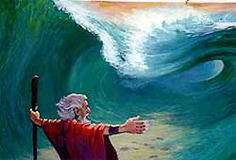

There Are No Silver Bullets
Notes:
The committee concluded that there was no single answer to the flood challenge

Slide 19
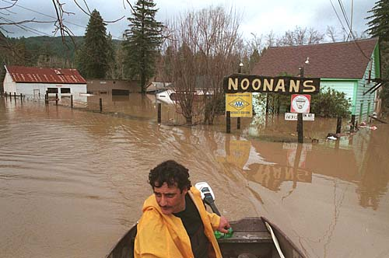
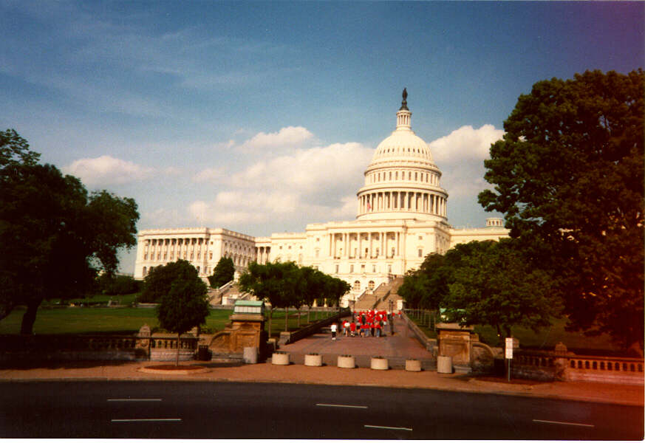
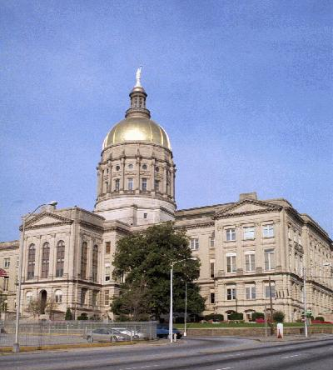
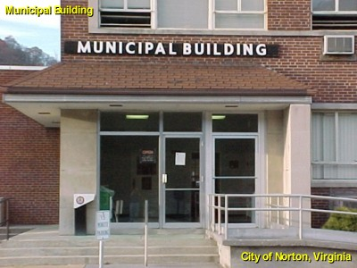
WHAT NEEDS TO BE DONE
Share Responsibility and Costs for Floodplain Management Among Federal, State, and Local Governments and Impacted Populace

Slide 20
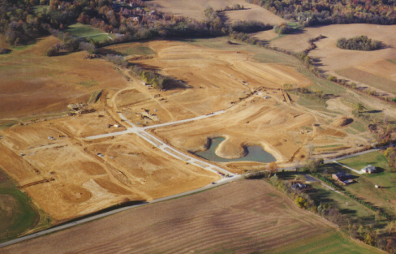
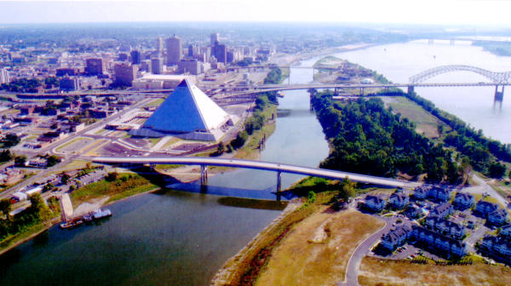
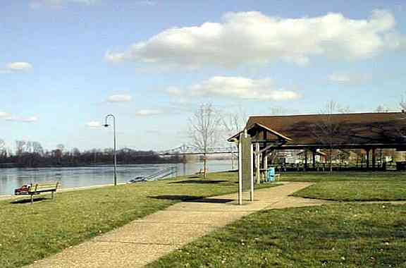
Avoid Use of Floodplain: Don't Develop When You Don't Need To

Slide 21
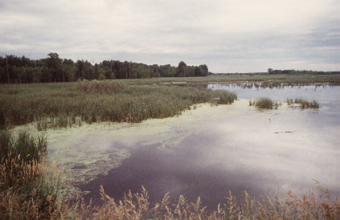
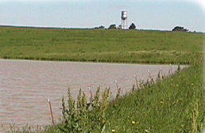
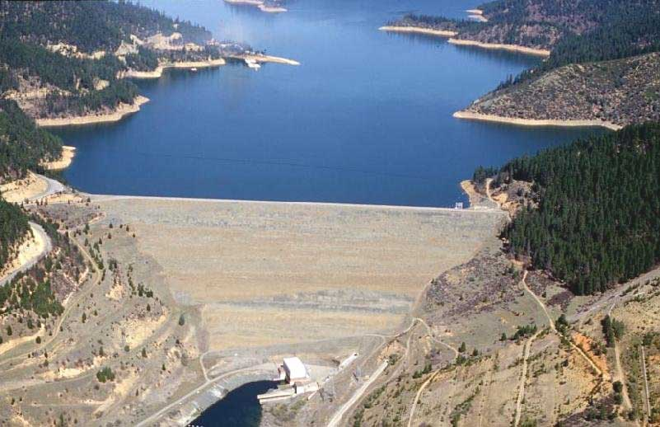
Minimize Damages to Development that Does Occur and Has Occurred
  Hold the Water Where It Falls

Slide 22

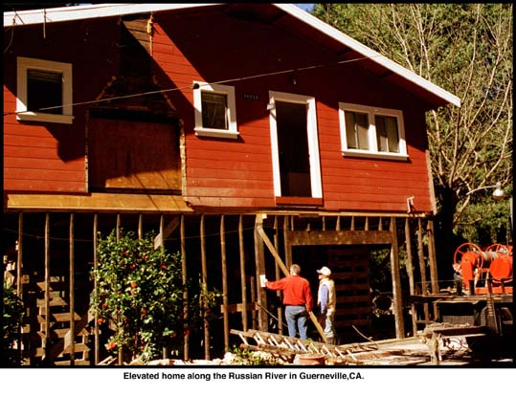
Minimize Damages to Development that Does Occur and Has Occurred
  Floodproof

Slide 23
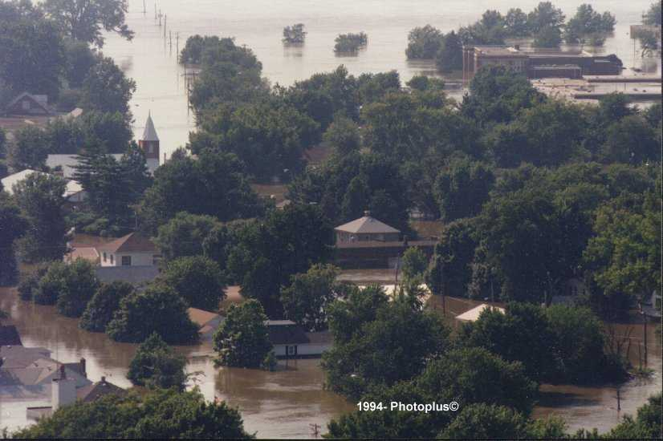
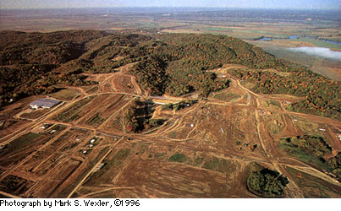
Minimize Damages to Development that Does Occur and Has Occurred
  Relocate Endangered Structures (Buyouts)
  Acquire Marginal Lands

Slide 24
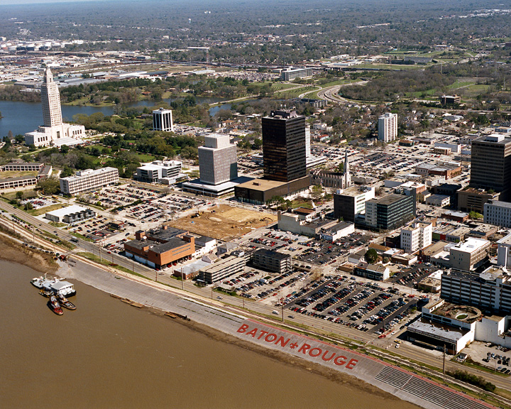
Minimize Damages to Development that Does Occur and Has Occurred
  Use Levees/Floodwalls, When Justified

Slide 25
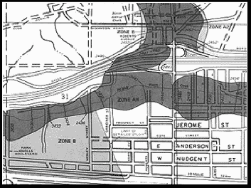
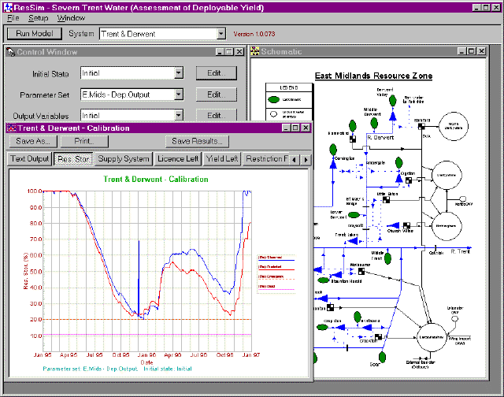
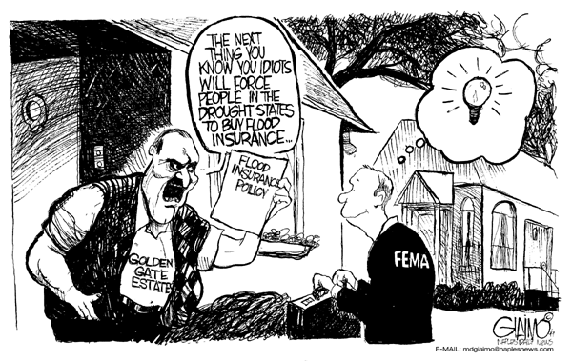

Mitigate Damages that Will Occur
  Insure Those at Risk
  Educate Present and Potential Floodplain Occupants

Slide 26

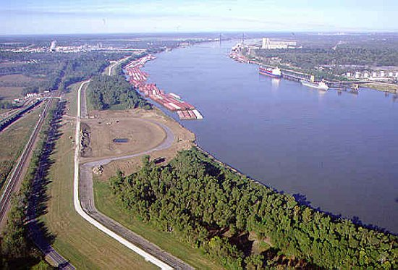
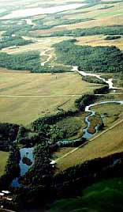
Deal with the River Basin as a System
Concurrently Restore, Maintain and Enhance the Natural Environment

Slide 27

What Have We Learned?

Slide 28

What Have We Learned?
The Future Will Be Different than the Past

Slide 29


The 21st Century
"Toto, I've a feeling we're not in Kansas anymore”

Slide 30

The 21st Century
Population Explosion
Pressures for Development
Crumbling Infrastructure
Volatile, Uncertain, Complex, Ambiguous National and World Situations (VUCA)
Climate Change and Disasters!

Slide 31
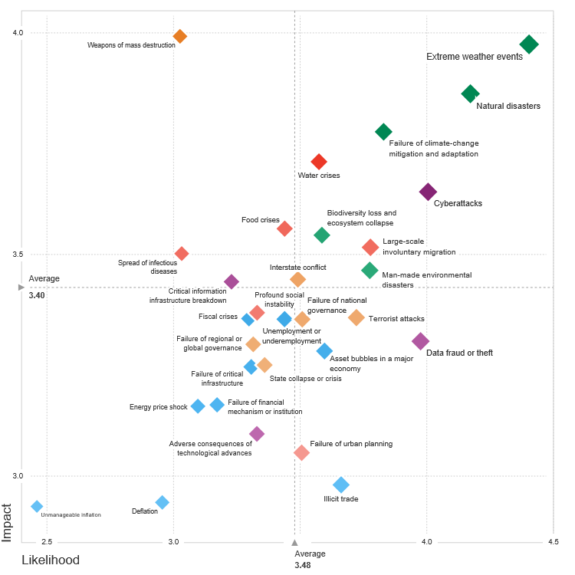
The Global Risks Landscape 2018. What is the impact and likelihood of global risks?
World Economic Forum

Slide 35
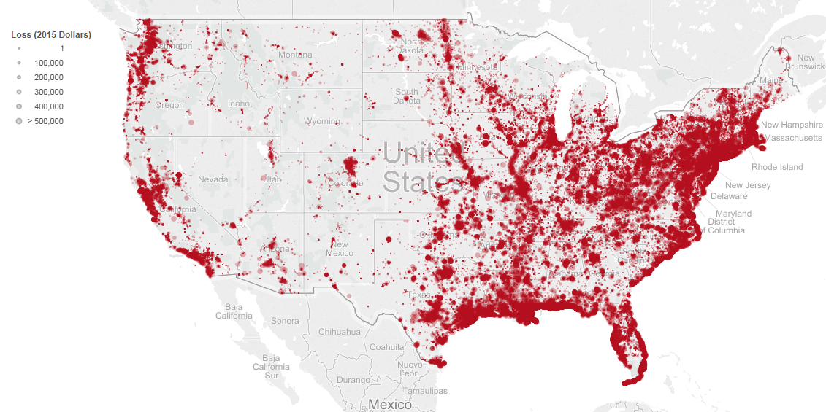
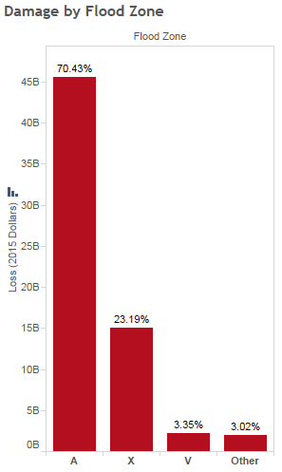
Insured Flood Loss: 1972-2015

Slide 36
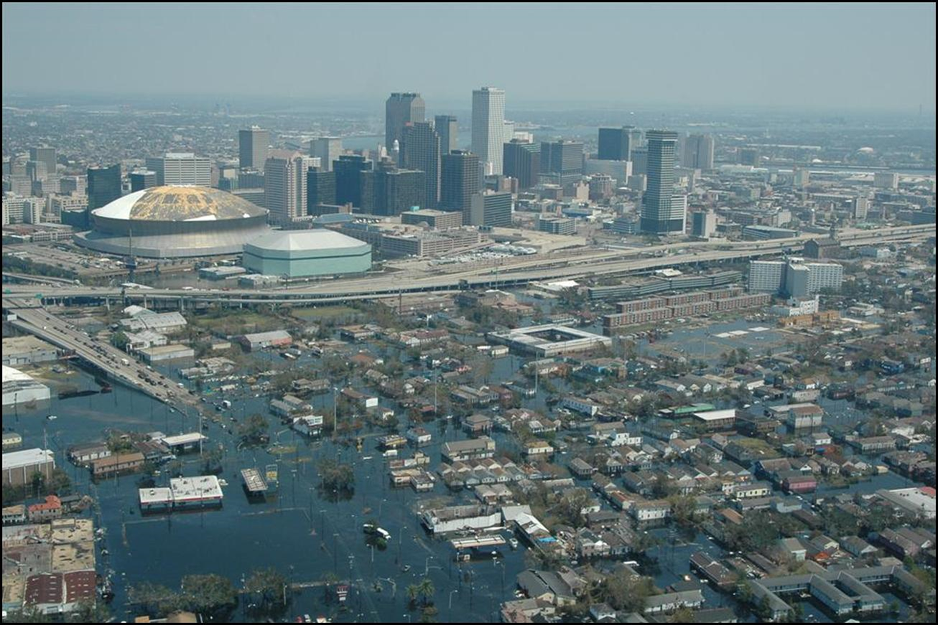
What Have We Learned?
There Is No Such Thing As Absolute Protection

Slide 37
The Move to Risk Management
The Flood Example
A willingness to live with floods
Individual and small communities adapt to the natures rhythm.
A desire to utilise the floodplain
Fertile land in floodplain is drained for food production.
A need to control floods
Large scale structural approaches are implemented through organised governance.
A need to reduce flood damages
A need to manage risk
A recognition that not all problems are equal.
A recognition that engineering alone has limitations.
Permanent communities are established on the floodplain.
Effort is devoted to increasing the resilience of communities should a flood occur.
Risk management is seen as an effective and efficient means to maximise the benefit of limited investment.

Slide 38
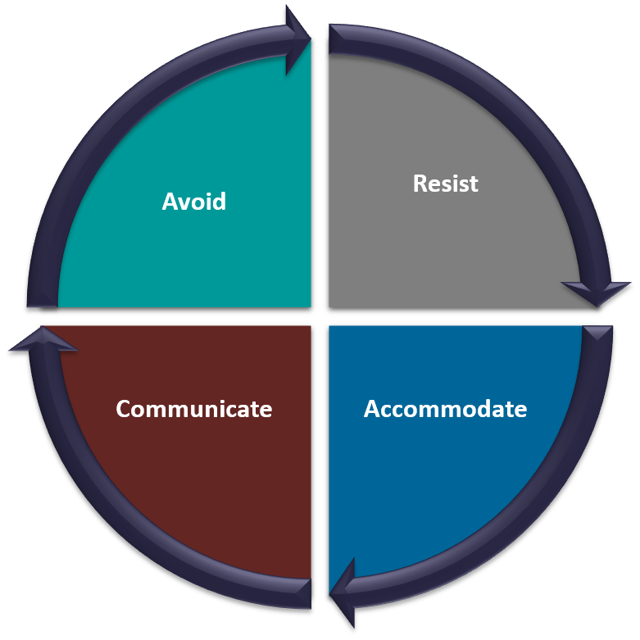
Flood Mitigation Framework
Avoid:
  Get Out of the Way
Accommodate:
  Let It Flood
Resist:
  Stand and Fight
Communicate:
  Tell The Story of Risk

Slide 39
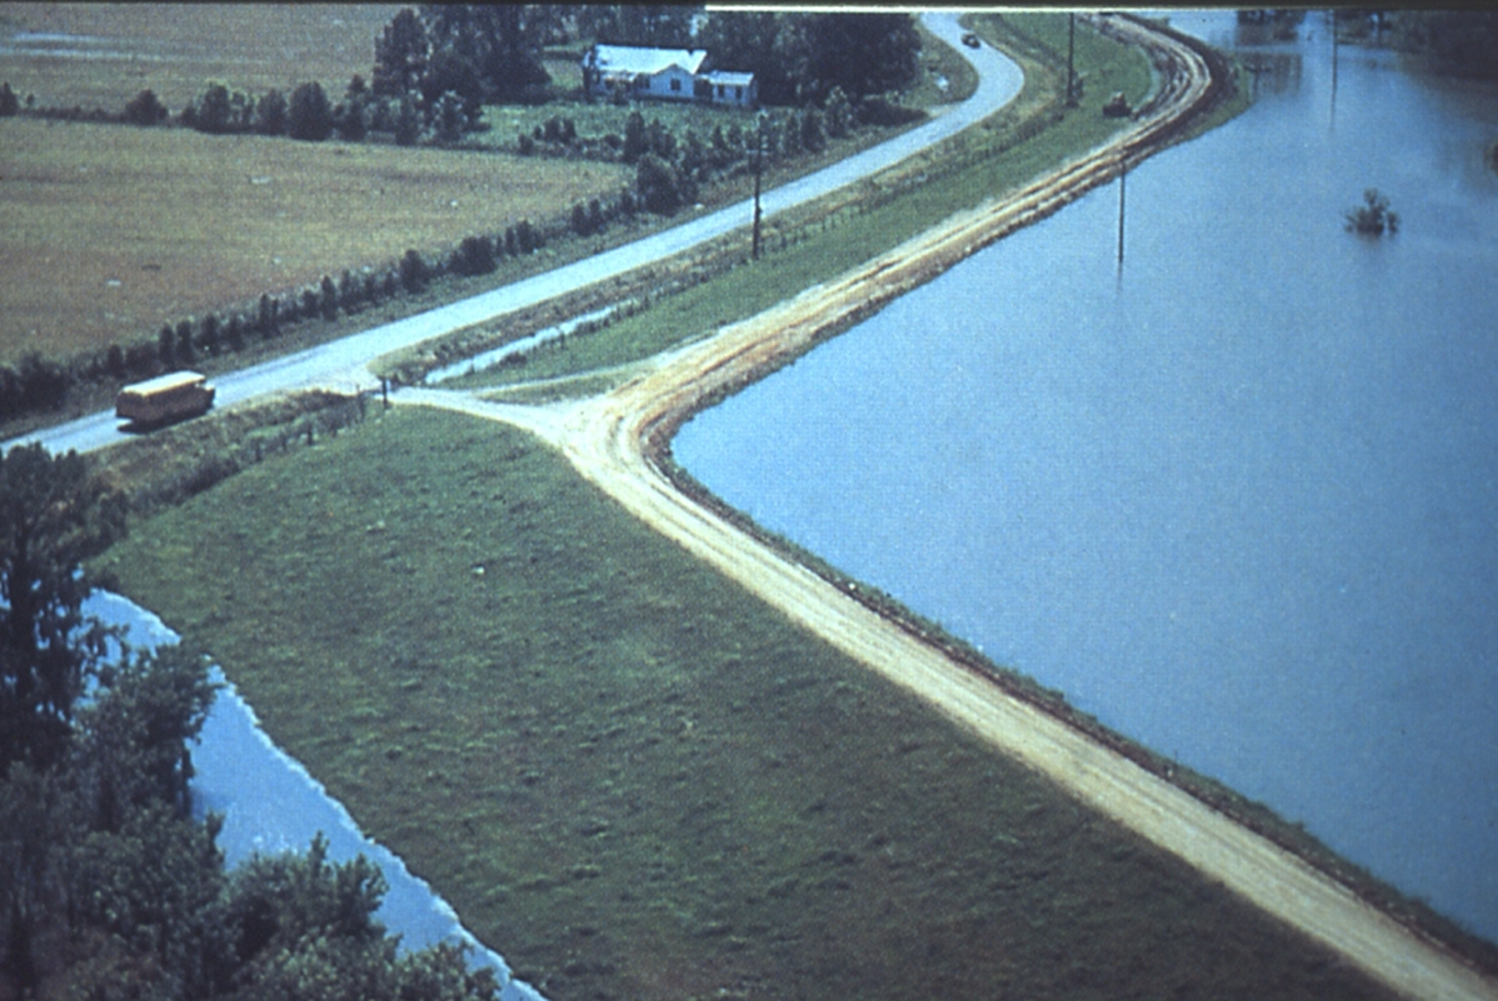
What Have We Learned?
Levee Is Not a Four Letter Word, but…

Slide 40
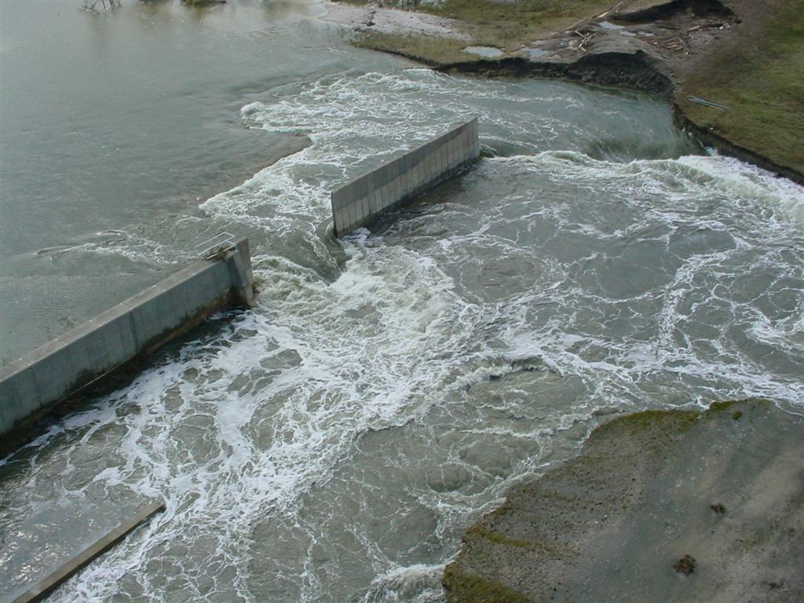
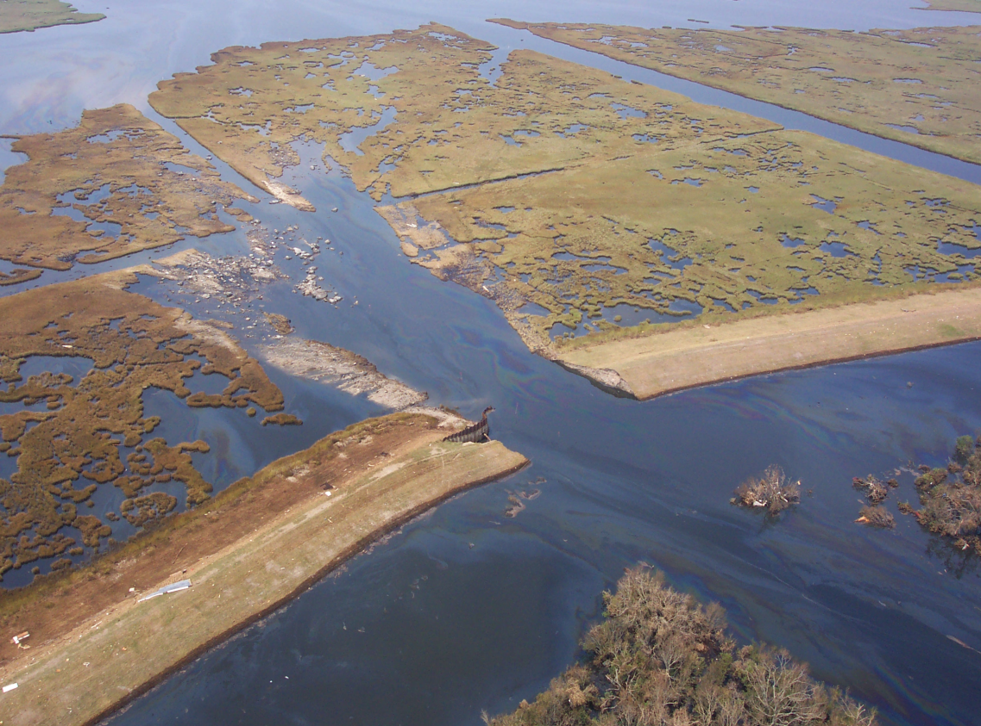


Levees Fail or Overtop

Slide 41

Levees only reduce the risk to individuals and structures behind them They do not eliminate risk
The residual risk that exists for those who are protected by levees and the in-out nature of the protection that levees provide create a major challenge and risk.
Notes:
41

Slide 42

Use All Tools in the Risk Management Effort
Risk

Slide 43
What Have We Learned?
Relocation and Elevation do Work, but….

Slide 44

55,000+ Buyouts

Slide 45

Notes:
People who live in a floodplain and want to stay there need to flood proof your property

Slide 46


NY TIMES

Slide 47
What Have We NOT Learned?

Slide 48

What Have We NOT Learned?
How to Pay for Infrastructure

Slide 49

Not Maintaining and Upgrading Our Infrastructure
Corps of Engineers [studies]… suggest that a large percentage of private or locally built levees…are or can be expected to be poorly designed and maintained (1981)
Nation’s infrastructure is being neglected (ASCE)
Notes:
49

Slide 50



Need to come to grips with the need for fiscal support for gray and green infrastructure development and renewal and make these resources available.
Accept that there is no free lunch and pay our way.
Use Innovative resource approaches (Infrastructure banks, etc).
Let beneficiaries pay
D
Gabriel Utasi AZ

Slide 51
What Have We NOT Learned?
How to Get People to Buy Flood Insurance (and Where)

Slide 52
Harvey -Houston 2017
Green: Flood Insurance Purple: IA
55,570 (36%) had flood insurance.
Only 23% of 239,430 policy holders flooded

Slide 53
Harvey -Houston 2017 154,170 Homes Flooded
32% < 100-yr
23% > 100 yr < 500 yr
46% > 500 yr
~ 10% of all buildings in Harris County

Slide 54

What Have We NOT Learned?
How to Deal With Urban Flooding

Slide 55
1993 Mississippi River Flood
Nearly 50 percent of the approximately 100,000 homes damaged, suffered losses due to groundwater or sewer backup [and sheet flows] as opposed to riverine flooding.

Slide 56



Slide 57
On Whom Is the Greatest Impact?
From Brad Winters, IL DNR

Slide 58

Expect the Unexpected

Slide 59

What Have We NOT Learned?
How to Communicate Flood Risk

Slide 60
Effectively Communicate Flood Risk
Harmonize Federal Messages
Push Support to Local Level
Use all Communication Tools including Risk Maps
In Flood Zone
In Flood Zone
OUT
OUT

Slide 61


Risk Maps

Slide 62


Slide 63


Slide 64
What Have We NOT Learned?
Development of Effective Policy and Governance

Slide 65
Organizing for the Future
The current flood damage reduction system in the upper Mississippi River Basin represents a loose aggregation of federal, local, and individual levees and reservoirs. This aggregation does not ensure the desired reduction in the vulnerability of floodplain activities to damages. \
Responsibility and costs for floodplain management should be shared among federal, state, and local governments and impacted populace
Notes:
While many of its comments were general, it did make specific comments about levees in the Midwest noting that there was no system available to coordinate many levees that were being built by nonfederal entities. It also noted thatmany of these nonfederal levees were in poor condition and received very little supervision. It also found that the level of protection provided to urban areas in many cases was less than was needed

Slide 66







Slide 67




Project Impact: Building A Disaster-Resistant Community
P&G
Biggert-Waters 2012
FFRMS

Slide 69
SO?

Slide 70
DO SOMETHING!
ACT!

Slide 71

The Desired 2050 Floodplain
Flood risk and land and water resources managed towards more sustainable outcomes.
Nation views land and water as precious resources, and protects the natural and beneficial functions; Maximum amount of natural mitigation of flooding takes place continually.
Development is designed and built so that it has no adverse impacts; Market strongly favors sustainable development - floodprone construction rarely occurs.
Risk communication through all levels of government has become advanced enough that local decision making is well informed
Policy decisions are based on sound science.

Slide 72

You Need to Be Involved
  Technically – Helping Develop Standards – Informing with Science
  Educationally – Explaining to Others Why Levee are Important
  Ethically – Speaking When King Has No Clothes
  Politically/Institutionally - Becoming Involved in the Decision Process
You Make the Difference!

Slide 73

W

Slide 74


Slide 75


Thank You!

Slide 76
Here’s Chad!!

